Slide 1
A Smart Poultry Litter Tracking and Alert System
By,
Irfan H A

Slide 2
CRISP-ML(Q) Methodology:
Business and Data Understanding
Data Preparation
Model Building
Model Evaluation
Model Deployment
Monitoring and Maintenance

Slide 3
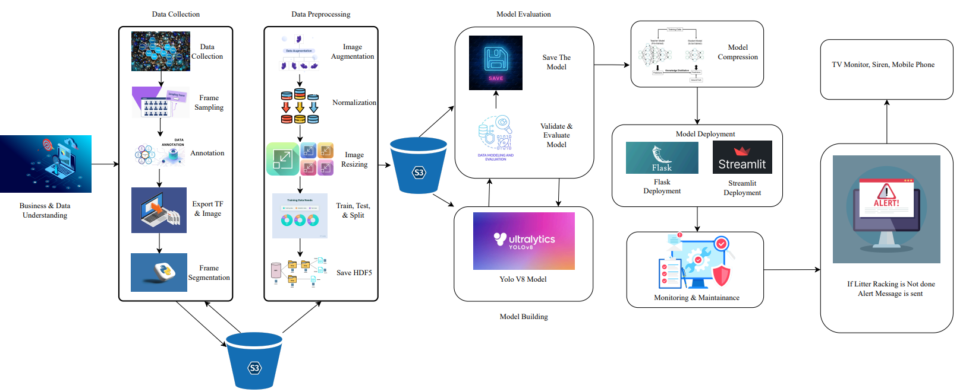
Project Architecture:

Slide 4
Business Problem:
Neglecting proper litter management in poultry farming creates an environment that contributes to the buildup of pathogens and ammonia. This poses a threat to the respiratory well-being of birds, increase the risk of diseases, and undermines the overall success and sustainability of the poultry enterprise
Business Objective:
The Business Objective is to maximize poultry health through effective litter management practices, reducing disease risks and enhancing productivity.
Business Constraint:
Maximize the cost of the solution while maintaining effectiveness in maximizing poultry health

Slide 5
Success Criteria:
Business Success Criteria:
Minimize manual efforts by at least 10% through the implementation of the automated litter management tracking system.
Machine Learning Success Criteria:
Achieve a minimum accuracy of 96% in detecting deviations from scheduled littering times and predicting poultry health outcomes through machine learning algorithms implemented in the tracking system
Economic Success Criteria:
Achieve a cost saving of at least $1million through improved efficiency and reduced operational costs facilitated by the automated litter management tracking system

Slide 6
Technical Stacks:
Python
Google Colab
Ultralytics
CV2(OpenCV)
Roboflow

Slide 7
User Interface:
Streamlit app.py (for deploying YOLOv8 Model)
Hardware Specification:
Processor: Intel Core i5
RAM Size: 12GB
Operating System : Windows 11

Slide 8
Data Collection and Understanding:
Primary Data Source:
YouTube videos and online photos depicting manual litter racking
Data Extraction:
Frames Extracted from videos and images sourced from Google, featuring either human, machine or both engaged in litter racking activities
Number of images / Frames:
Approximately 6000

Slide 9
Data Preparation with RoboFlow:
Annotation:
Bounding Box Annotation with Labels:
Human
Machine
Pre-Processing steps:
Auto Orient
Resize

Slide 10
Data Preparation with RoboFlow:
Augmentation Techniques:
Brightness
Exposure
Blur
Noise
Flip

Slide 11
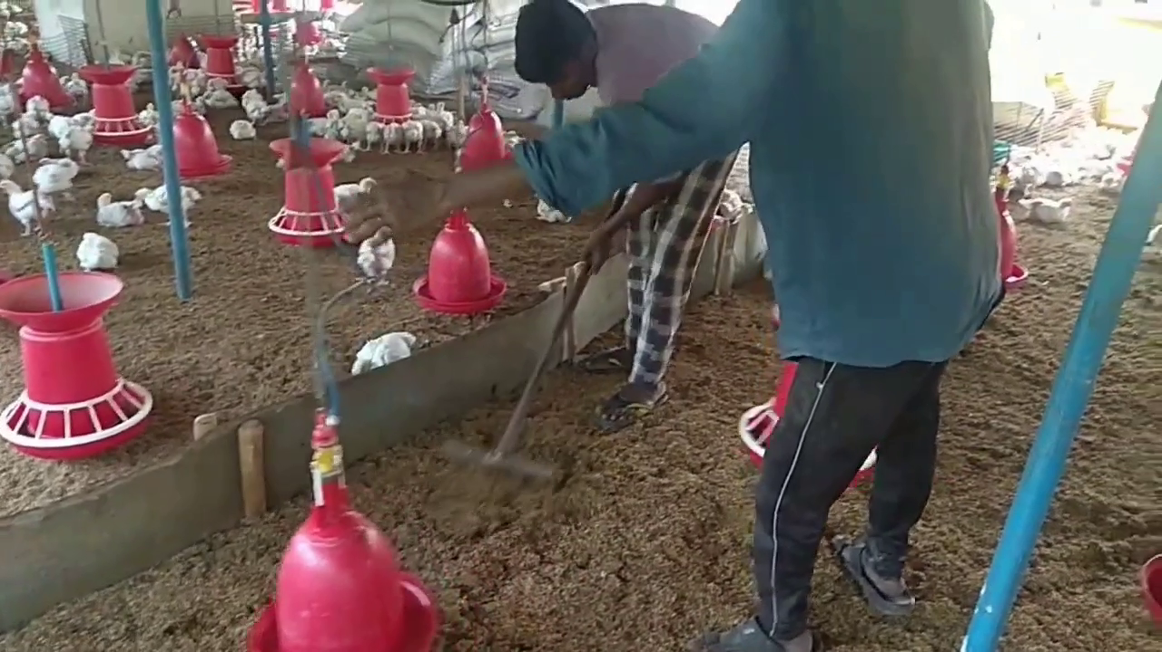
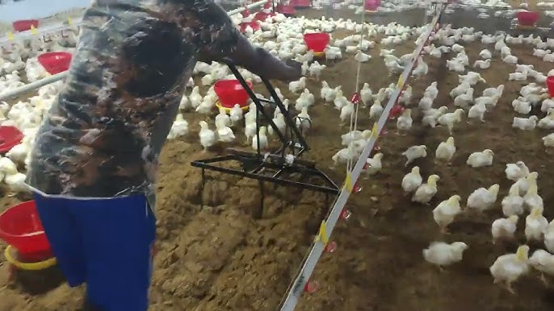
Initial Image Visualization:
Notes:
Change

Slide 12
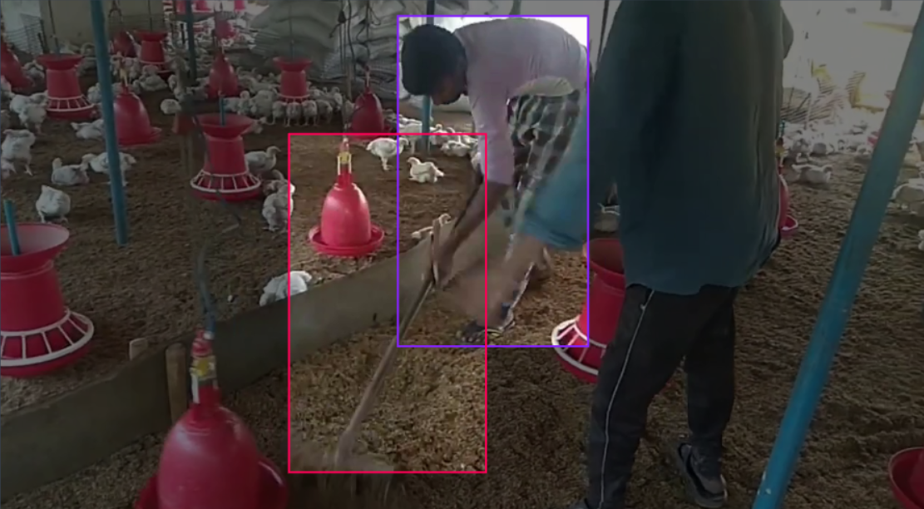
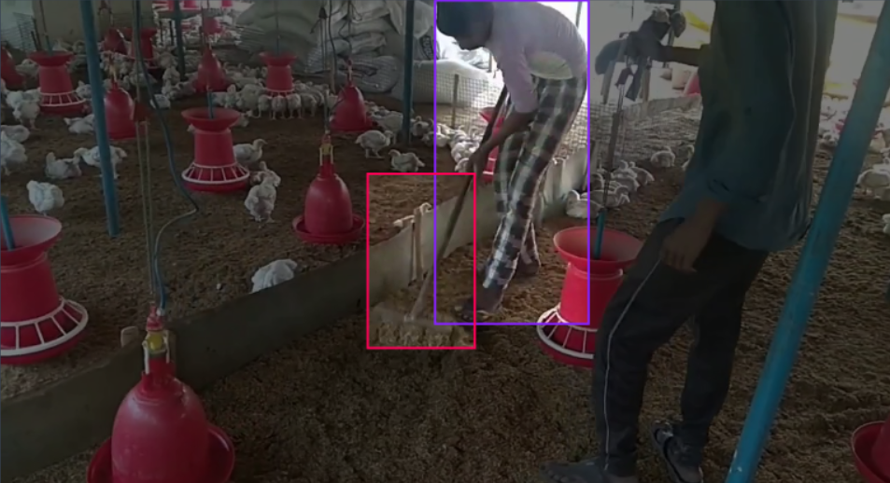
Annotated Image Visualization:

Slide 13
Model Building:
Utilizing YOLOv8 model:
We implemented YOLOv8m model for object detection
Training Configuration:
Epochs: 20
Batch size: 6

Slide 14
Performance and Model Evaluation:
Performance Metrics:
Average Precision metrics were computed for each class at different IoU thresholds
Overall performance : mAP50:90.4%, mAP50-95:58.3%
Model Evaluation:
Validation results show an overall mAP50 of 90.4% and mAP50-95 of 58.3%

Slide 15
Model Deployment:
Framework: Streamlit
Utilized streamlit for a micro web framework written in Python, for model deployment
User Interaction:
User can upload image or video to the we interface
Real – Time streaming:
Supports real- time video streaming of detected objects.

Slide 16
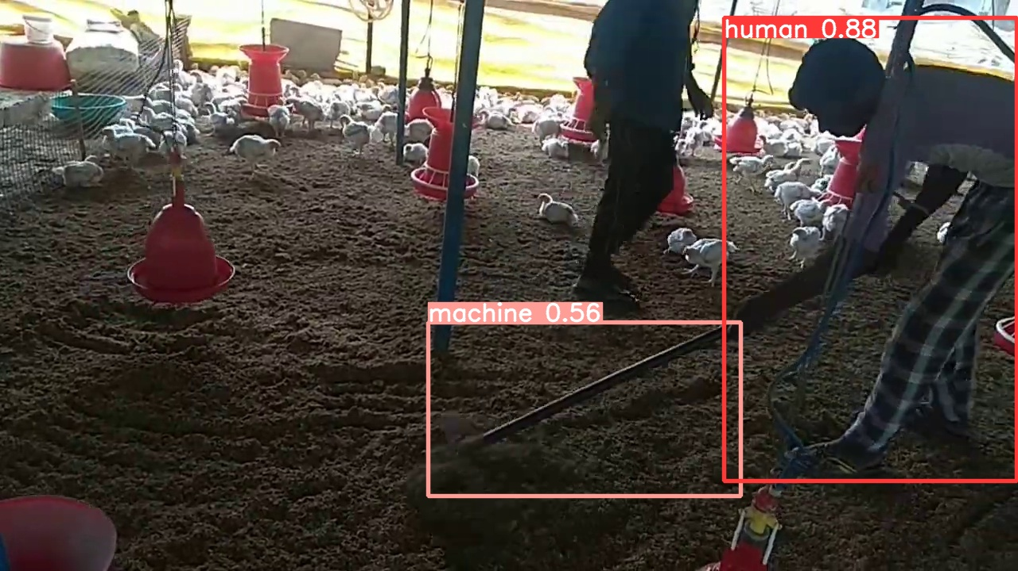
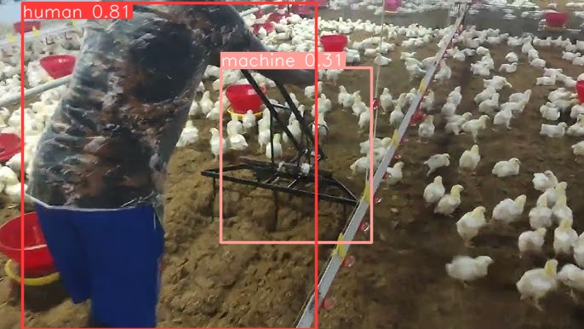
Output:

Slide 17
Challenges:
Time consuming image annotation process
Runtime errors encountered during model deployment
Issues with streamlit app functionality , such as sending alert SMS and handling image upload formats.

Slide 18
Future Scopes:
Expansion to other Agricultural Sectors:
Exploring opportunities to extend the solution’s capabilities beyond poultry farming to other agricultural sectors , such as livestock management or crop monitoring , leveraging the underlying technology for broader impact
Integration with IOT Devices:
Integrating the system with IOT devises for automated data collection and sensor – based monitoring for poultry environments

Slide 19


